Slide 1
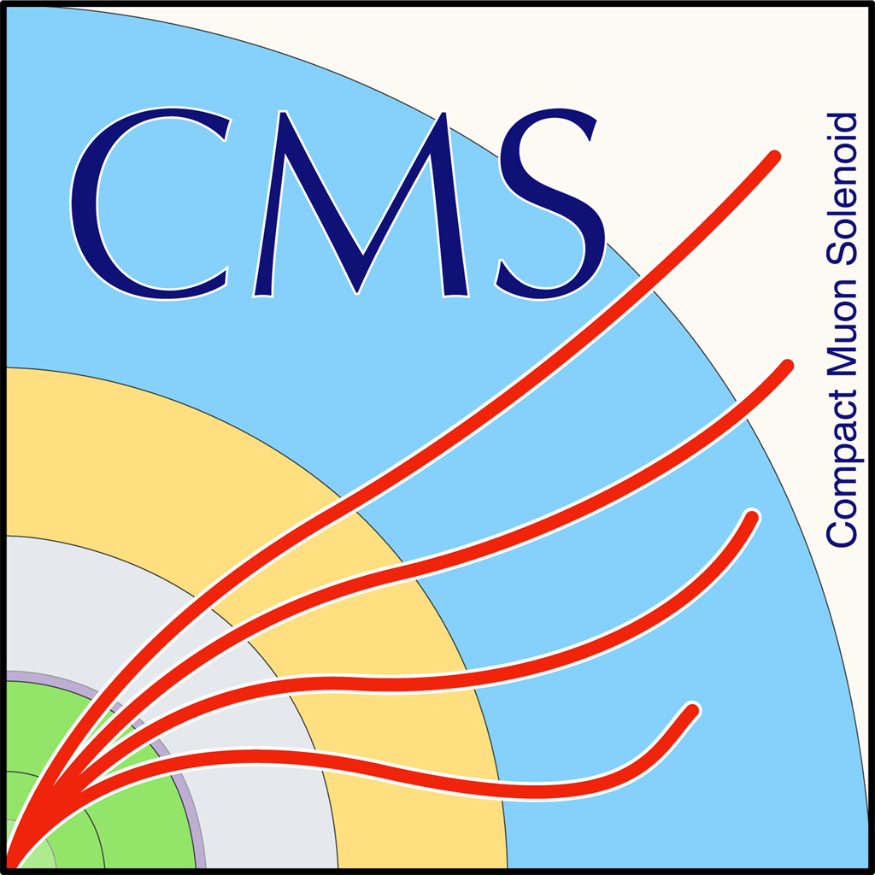

TopTagger, DeepAK8, event Mva comparison

Slide 2
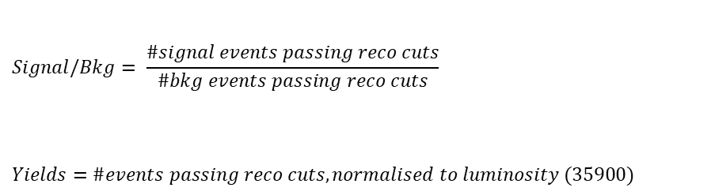
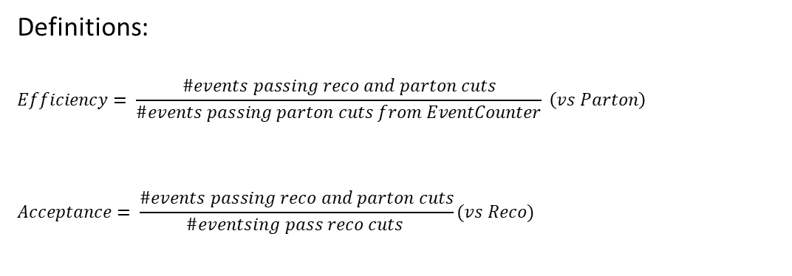
Overview
Efficiencies and Acceptance for mTT and jetPt variables
Selection:
Jet Matching
Parton cuts:
partonPt[0],[1] > 400
|partonEta[0],[1]| < 2.4
mTTbarParton > 1000
Reco cuts:
nJets > 1
nLeptons = 0
mJJ > 1000
jetPt[0],[1] > 400
|jetEta[0],[1]| < 2.4
bTagging (Medium WP)
Tagger cut (event mva, top Tagger, deepAK8)
JetMassSoftDrop > 120 and < 220
Definitions:
$$Efficiency= \frac{\#events passing reco and parton cuts}{\#events passing parton cuts from EventCounter} \left(vs Parton\right)$$
$$Acceptance= \frac{\#events passing reco and parton cuts}{\#eventsing pass reco cuts }(vs Reco)$$
$$Signal/Bkg= \frac{\#signal events passing reco cuts}{\#bkg events passing reco cuts}$$
$$Yields=\#events passing reco cuts, normalised to luminosity (35900)$$

Slide 3
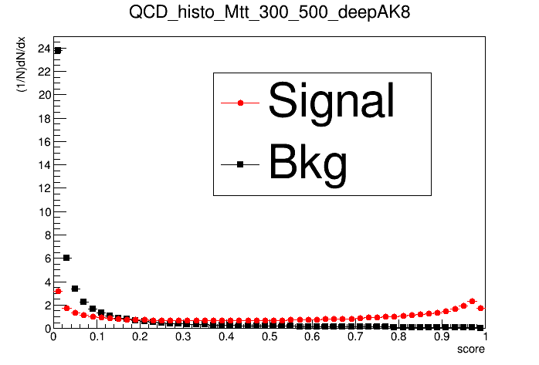
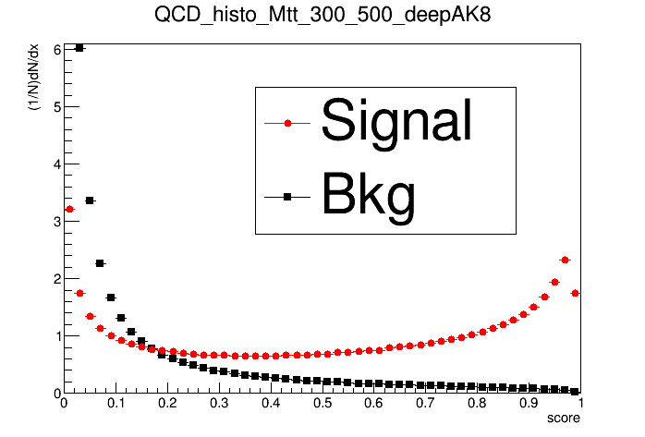
TopTagger, DeepAK8 comparison
Zoomed in

Slide 4
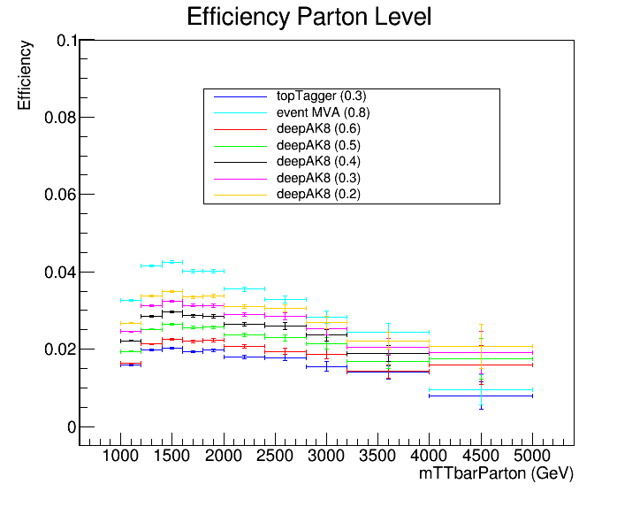
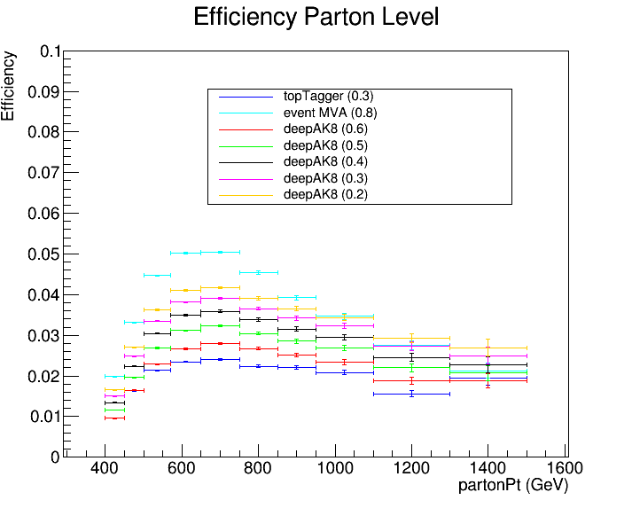
TopTagger, DeepAK8, event MVA Efficiency comparison

Slide 5
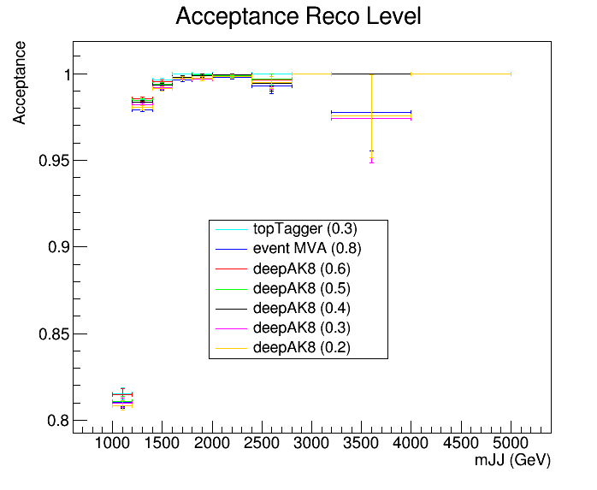
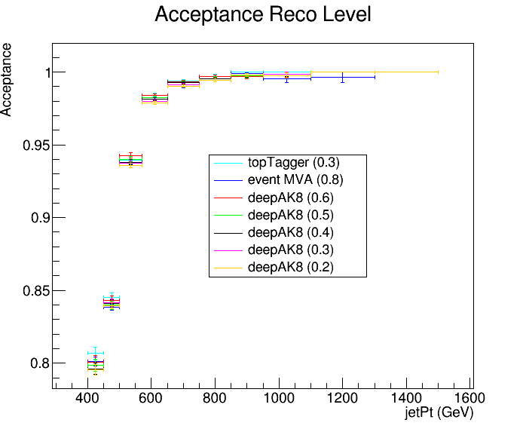
TopTagger, DeepAK8, event MVA Acceptance comparison

Slide 6
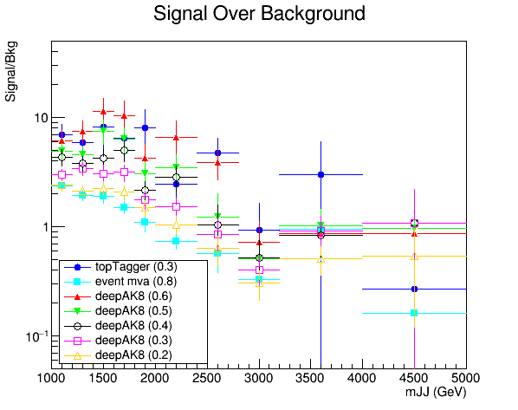
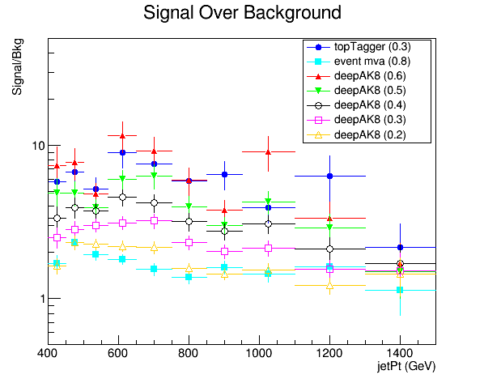
TopTagger, DeepAK8 comparison

Slide 7
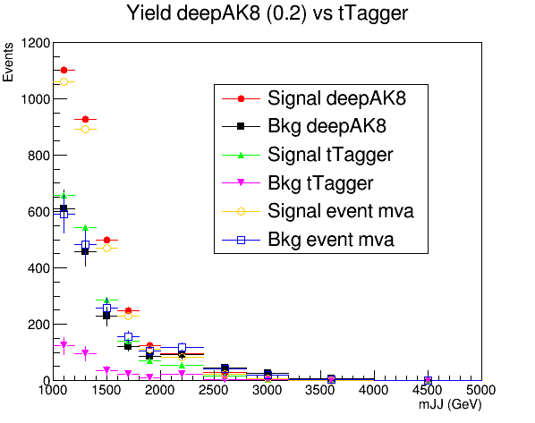
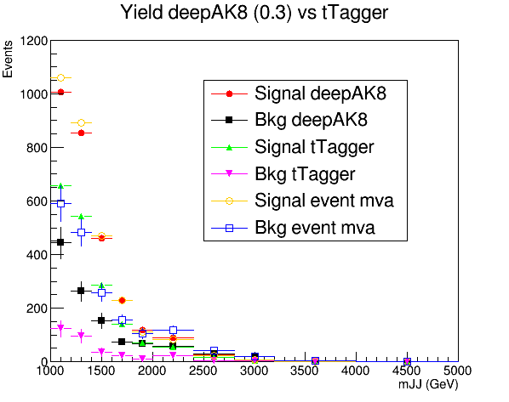
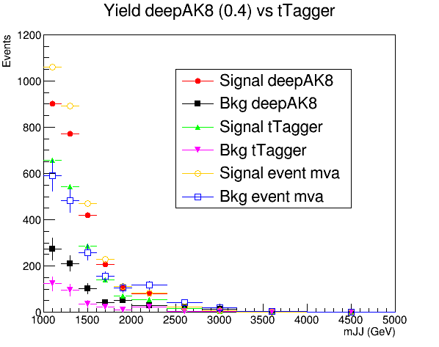
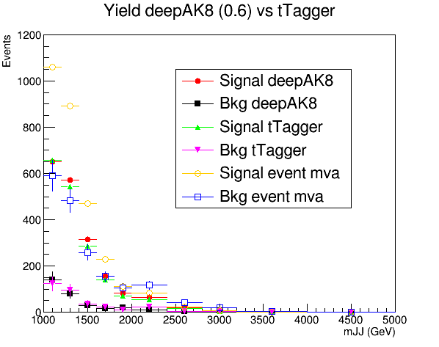
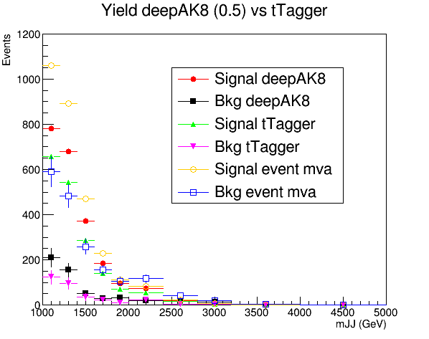

Slide 8
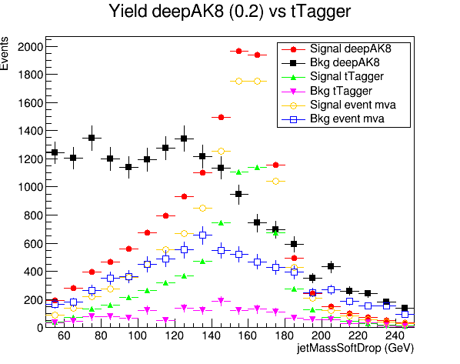
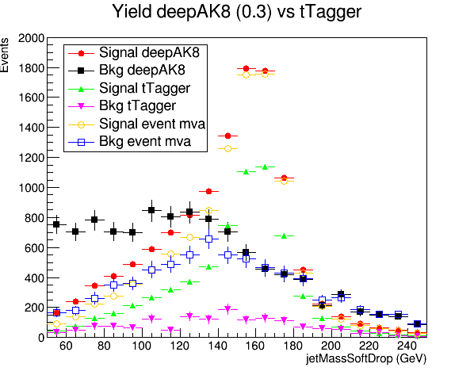
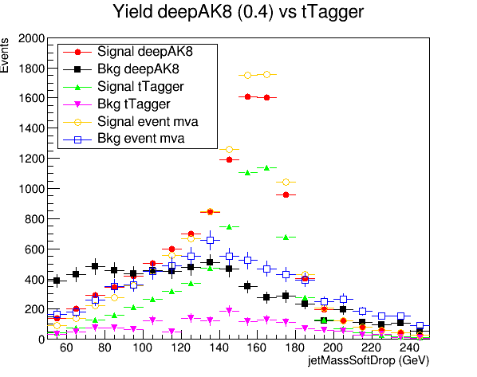
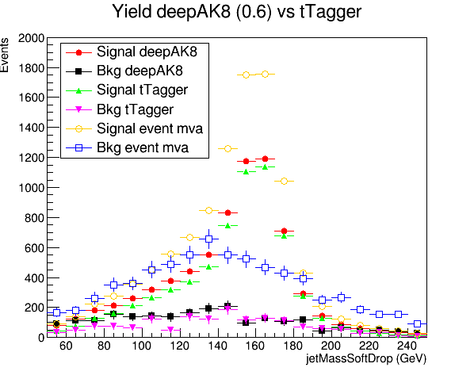
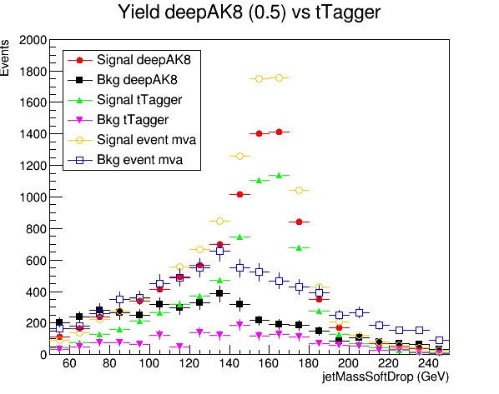

Slide 9
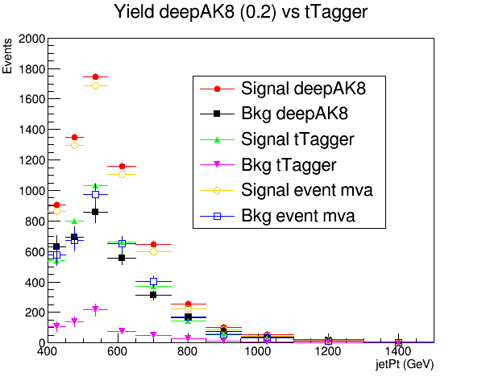
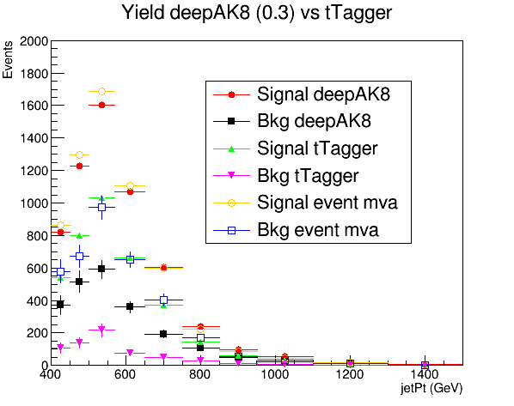
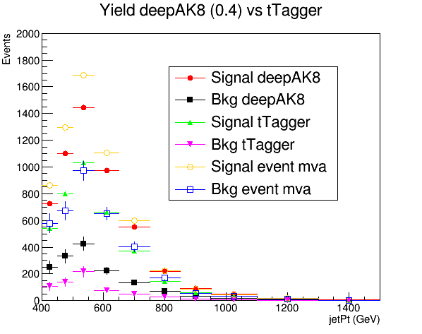
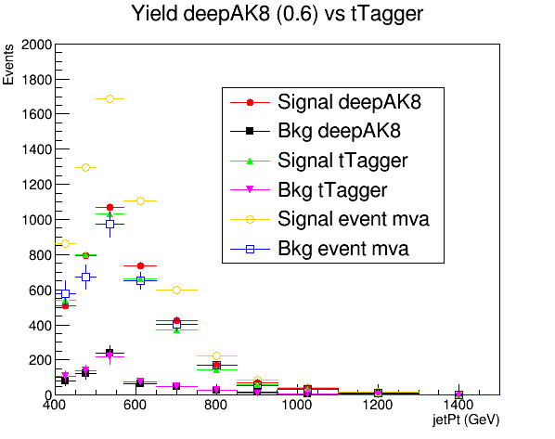
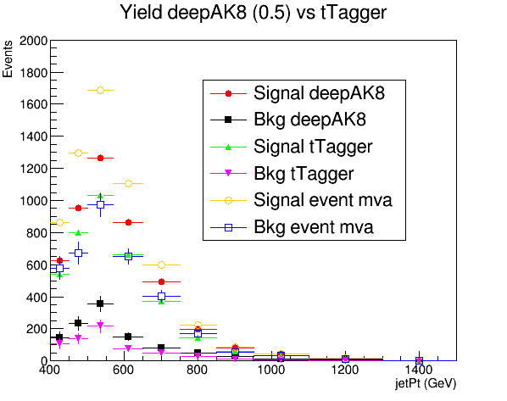

Slide 10
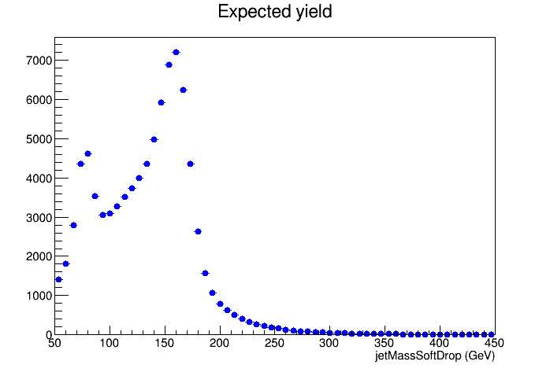
Jet Mass Soft Drop
Jet Mass Soft Drop distribution for Signal Sample only passing baseline selection

Slide 11
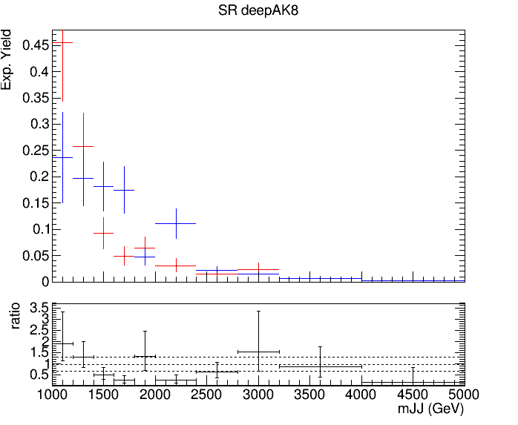
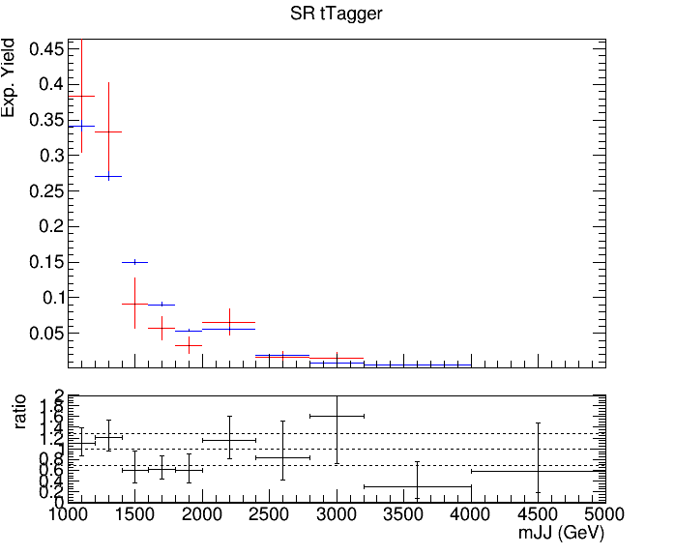
QCD Background MC closure tests
Closure test for QCD samples in Control Region (SR but btagging is reverted (btag==0)) for mJJ
tTagger
deepAK8
Control Region (0-btag)
Control Region (0-btag)
Signal Region (2-btag)
Signal Region (2-btag)

Slide 12
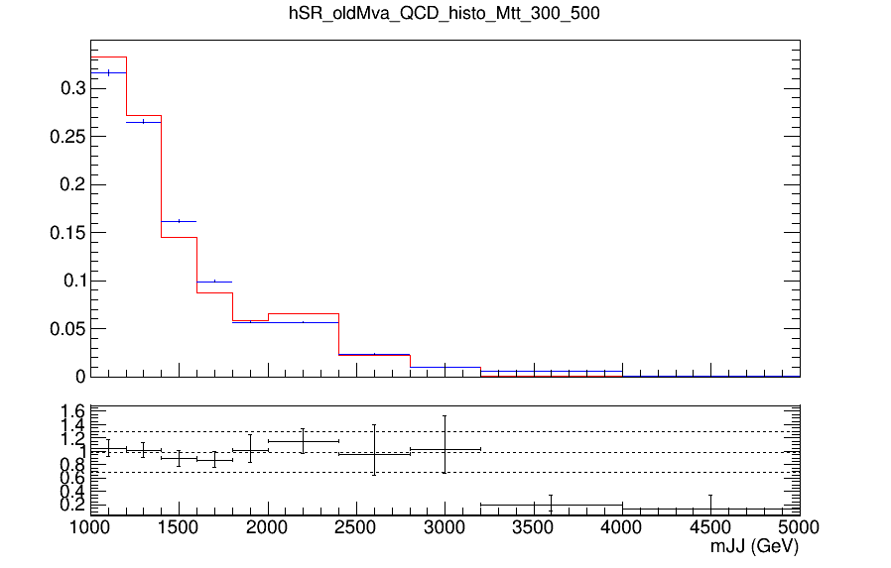
QCD Background MC closure tests
Closure test for QCD samples in Control Region (SR but btagging is reverted (btag==0)) for jetPt
oldMva
Control Region (0-btag)
Signal Region (2-btag)

Slide 13
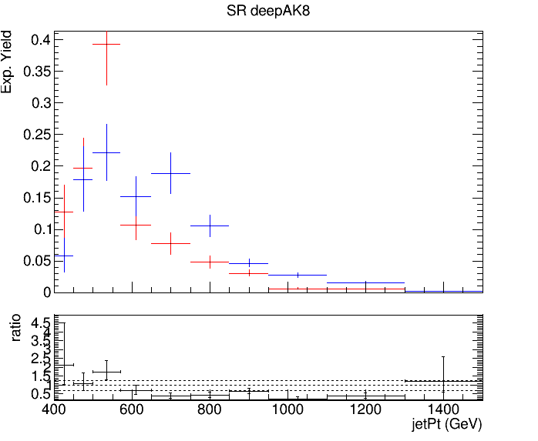
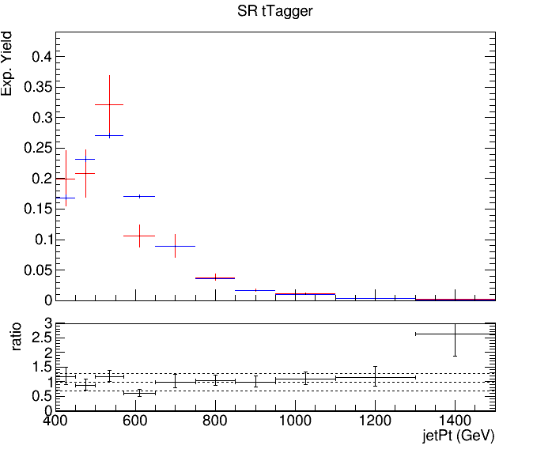
QCD Background MC closure tests
Closure test for QCD samples in Control Region (SR but btagging is reverted (btag==0)) for jetPt
deepAK8
tTagger
Control Region (0-btag)
Control Region (0-btag)
Signal Region (2-btag)
Signal Region (2-btag)

Slide 14
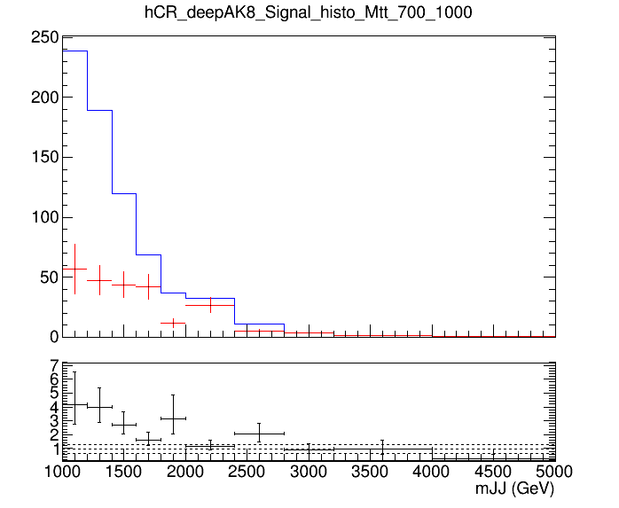
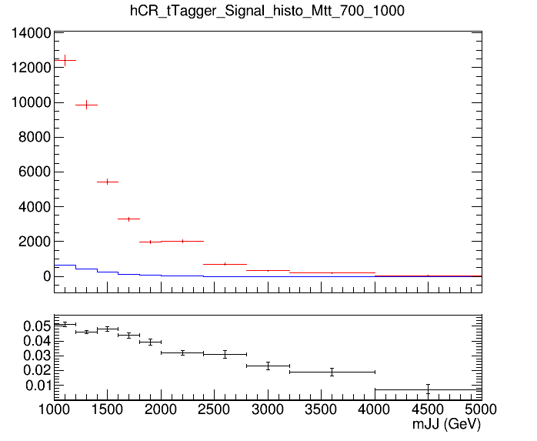
Control Region Contamination
Expected yield from QCD Bkg samples and TT Signal sample in the CR vs mJJ
deepAK8
Control Region QCD sample
Control Region QCD sample
tTagger
Control Region TT sample
Control Region TT sample

Slide 15
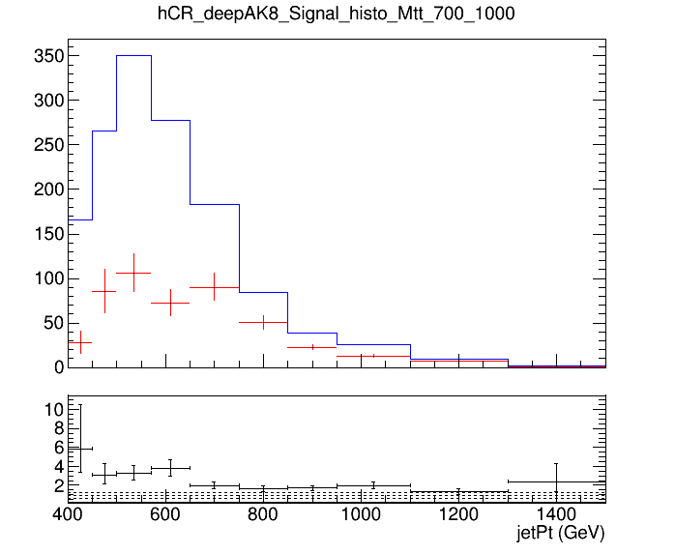
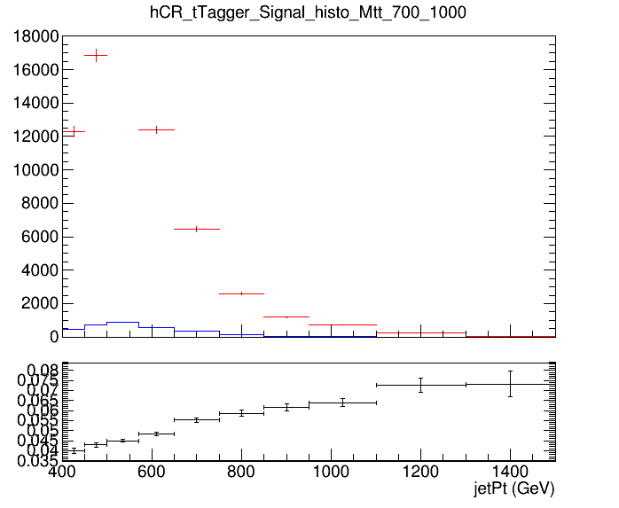
Control Region Contamination
Expected yield from QCD Bkg samples and TT Signal sample in the CR vs jetPt
deepAK8
Control Region QCD sample
tTagger
Control Region QCD sample
Control Region TT sample
Control Region TT sample

Slide 16
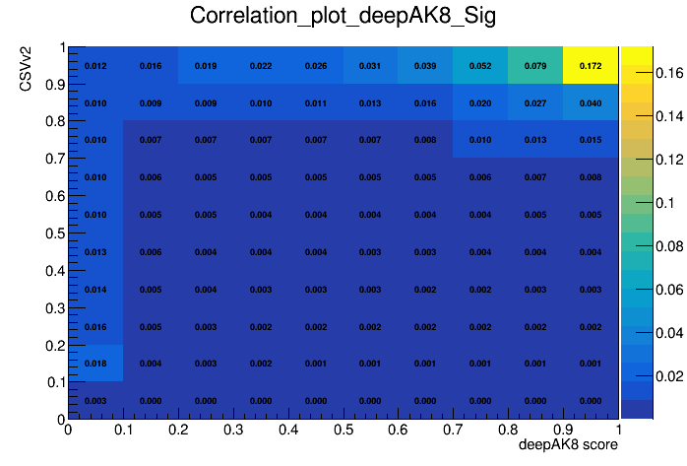
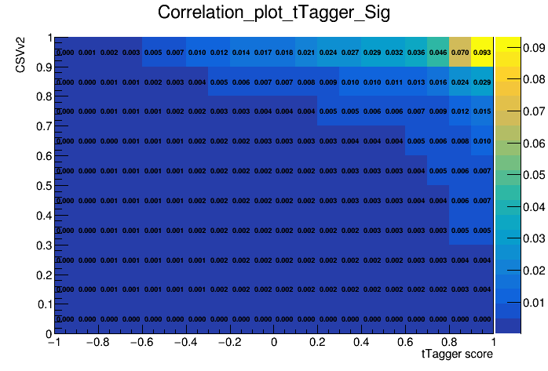
Btagging Correlation to DeepAK8 or TopTagger
How much is btagging affect the selection in deepAK8 or the TopTagger? (Signal)
deepAK8
tTagger

Slide 17
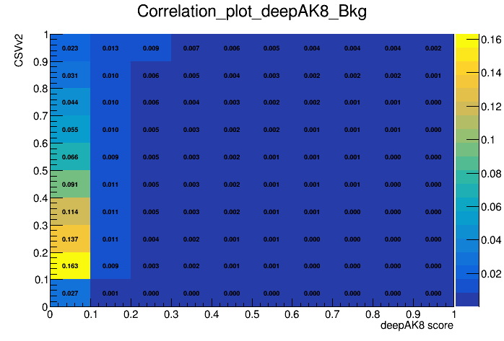
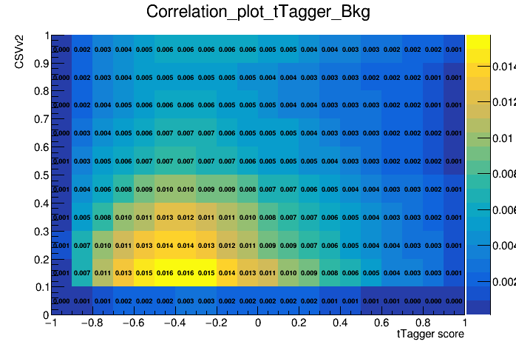
Btagging Correlation to DeepAK8 or TopTagger
How much is btagging affect the selection in deepAK8 or the TopTagger? (Signal)
deepAK8
tTagger

